Slide 1

ERP
IMPLEMENTATION

Slide 2

ERP
MAINTENANCE

Slide 3

ERP
CUSTOMIZATION

Slide 4







www
API
SYSTEM
INTEGRATION

Slide 5




INISIACORE
ACADEMY

Slide 6



Slide 7
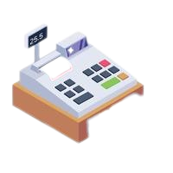



Slide 9



Slide 10

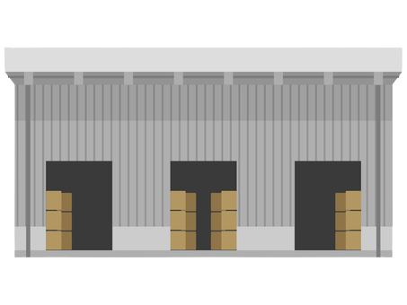



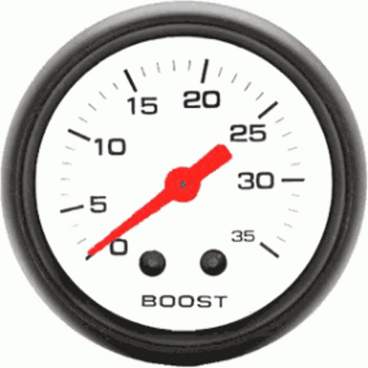


Slide 11


Slide 12




Slide 13



Slide 14


Slide 15


